Slide 1
Diabetes and Glucagon
Dave Bridges
dbridge9@uthsc.edu

Slide 2
Diabetes Mellitus
One of the first described diseases (1500 BC)
Named diabetes by Appolonius of Memphis (Egypt)
Diabetes (to pass through)
Mellitus (from honey)

Slide 3
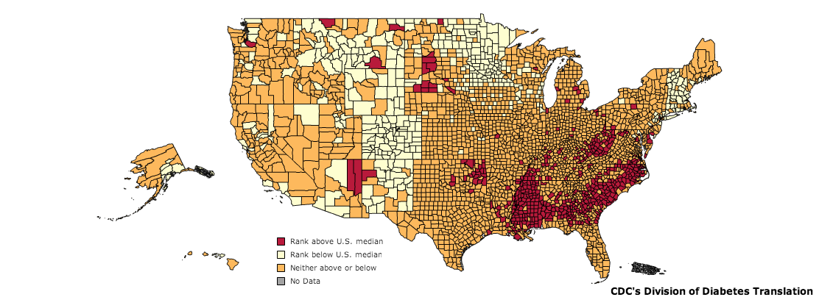
Diabetes in the United States
CDC, 2010
Notes:
As of 2011, diabetes affects 25.8 million people or 8.3% of the population. This includes approximately 7 million undiagnosed individuals. In addition to this, 79 million Americans over the age of 20 are estimated to be pre-diabetic. As of 2007, diabetes is estimated to cost $116 billion in direct and $58 billion in indirect costs [@CDC2011].
Diabetes is especially prevalent in this region. As shown in the map, there is a higher percentage of diabetics in the mid and deep south regions of the United States.

Slide 4
Complications of Diabetes
Retinopathy
Leading cause of blindness in 20-75 year olds
Nephropathy
30% to 40% of all diabetics are symptomatic
Neuropathy
risk of amputation >25 times greater than that of people without diabetes.
Cardiovascular
Heart Attack/Stroke Risk 2-4X with diabetes

Slide 5
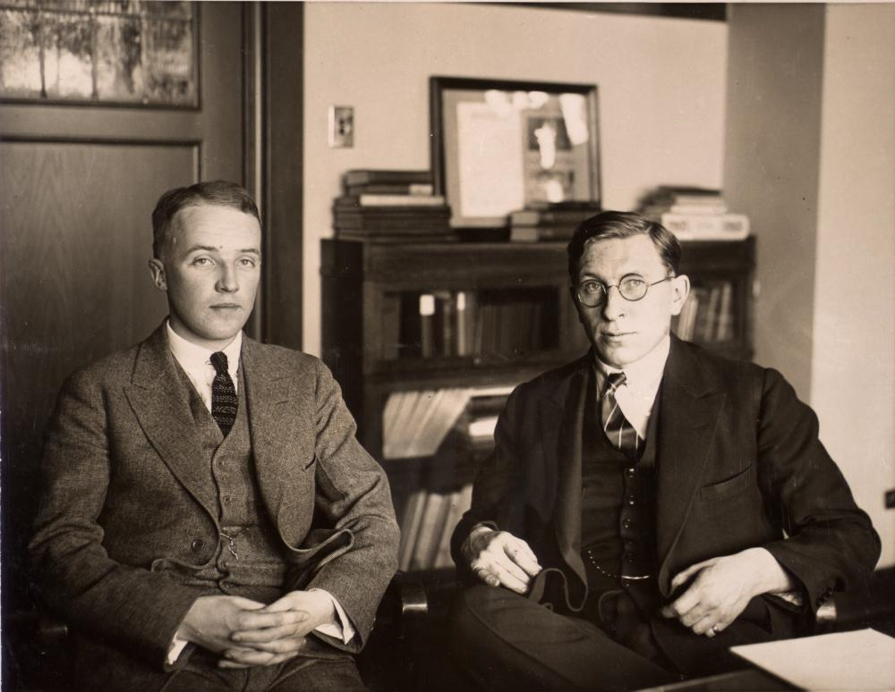
The Discovery of Insulin
Notes:
1889 von Mering and Minkowski (Pancreatectomy mimics disease)
Banting was a surgeon adept at pancreatectomizing dogs, Best was a lab technician who was very good at measuring blood glucose. MacLeod provided them lab space at the University of Toronto

Slide 6
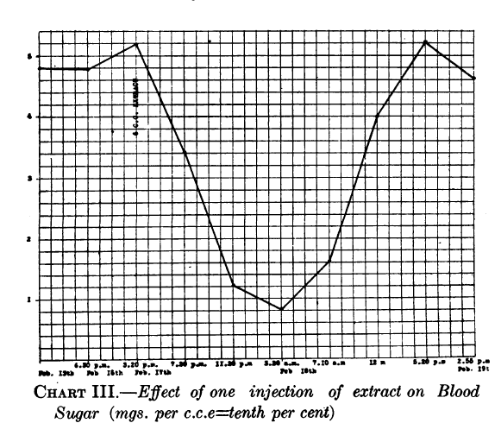
The Discovery of Insulin
Banting et al. 1922
Notes:
Insulin was discovered by Frederick Banting and his colleagues at the University of Toronto in 1921. They performed experiments in which they injected extracts
from pancreas fractions into dogs which had their pancreas’ surgically removed. They showed that a secreted substance from the pancreas lowered blood glucose
in these dogs (Frederick G. Banting and Best 1922). This is an image of dog pancreas isolate injected into a diabetic child

Slide 7
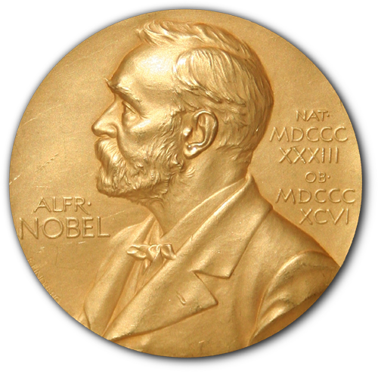
Nobel Prizes in Glucose Homeostasis
Banting and MacLeod (1923 – Discovery of Insulin)
Carl and Gerty Cori (1947 – Glycogen Regulation)
Krebs and Lipman (1953 – Glycolysis and Krebs Cycle)
Sanger (1958 – Sequencing Insulin Peptide)
Bloch and Lynen (1964 – Fatty Acid Metabolism)
Earl Sutherland (1971 – Second Messengers)
Brown and Goldstein (1985 – Cholesterol Metabolism)
Fisher and Krebs (1992 – Protein Phosphorylation)
Gilman and Rodbel (1994 – GPCR Signaling)
Rothman, Sheckman and Sudhof (2013 – Secretory Pathways)
Source: www.nobelprize.org

Slide 8


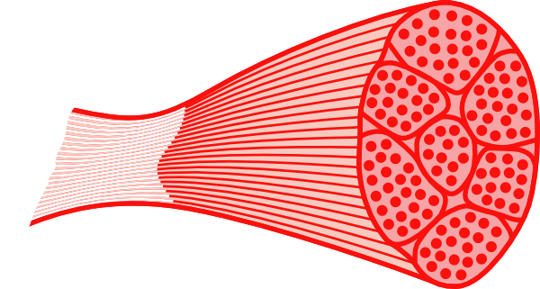
Regulation of Blood Glucose Levels
Gluconeogenesis
Disposal
Glucose Uptake
Glucose Storage
Glucose Utilization
Glucose Production
Glucose Uptake
Glucose Storage
and Utilization

Slide 9
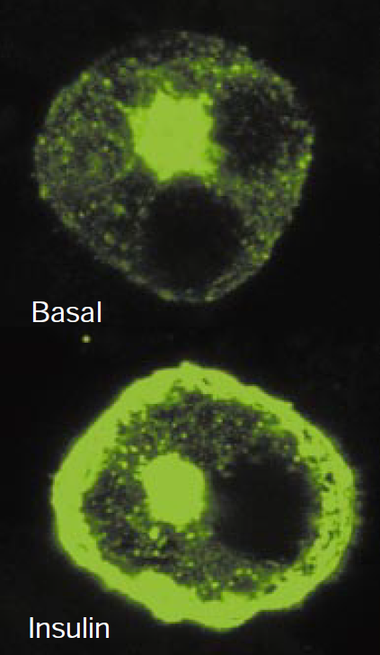
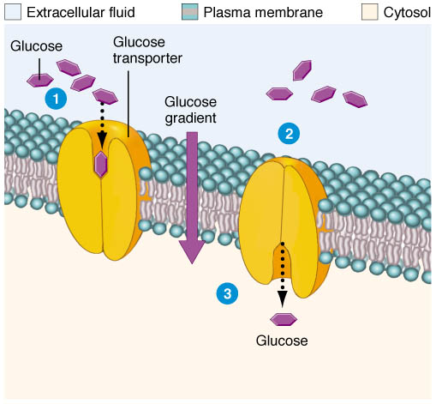
Glucose Uptake
Passive Glucose Uptake
Stimulated Glucose Uptake
Brain
Liver
Kidneys
Fat
Muscle
GLUT4-eGFP
From Saltiel and Kahn (2001) Nature 414:799-806
From http://classroom.sdmesa.edu/eschmid/Chapter3-Zoo145.htm

Slide 10
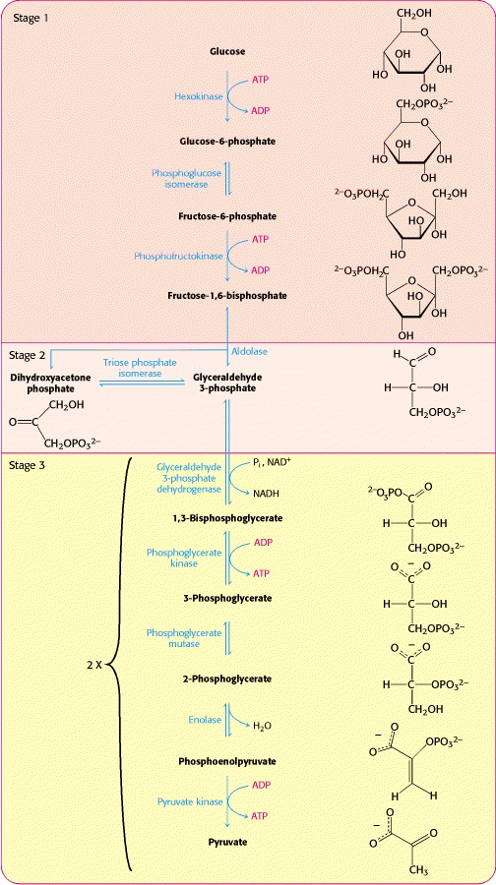
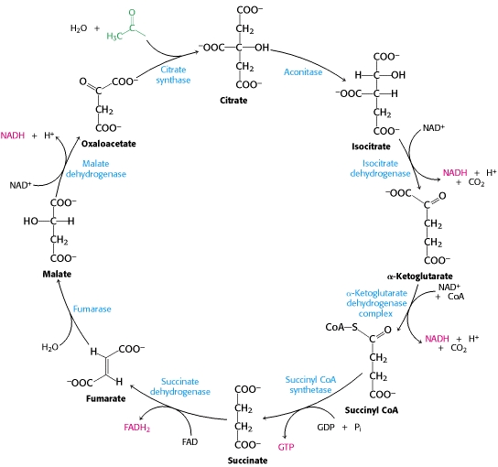
Glycolysis and Oxidative Phosphorylation
From Berg, Tzymozcko and Stryer Biochemistry (2002) http://www.ncbi.nlm.nih.gov/books/NBK22427
Notes:
These are the major glucose consuming pathways for energy generation

Slide 11
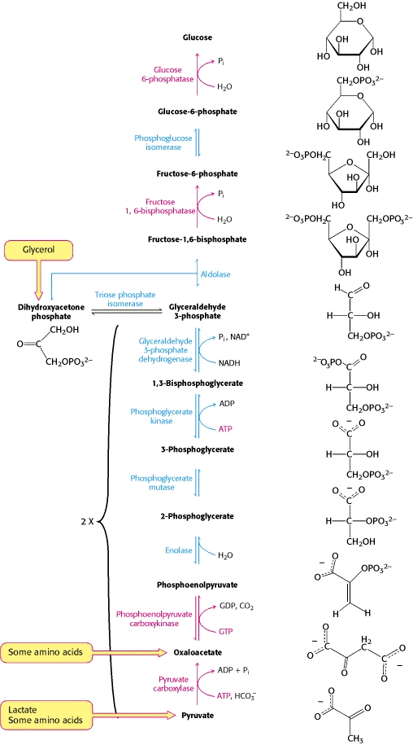
Gluconeogenesis
Uses amino acids and fatty acids to generate glucose
Key enzymes are PEPCK and FBPase

Slide 12
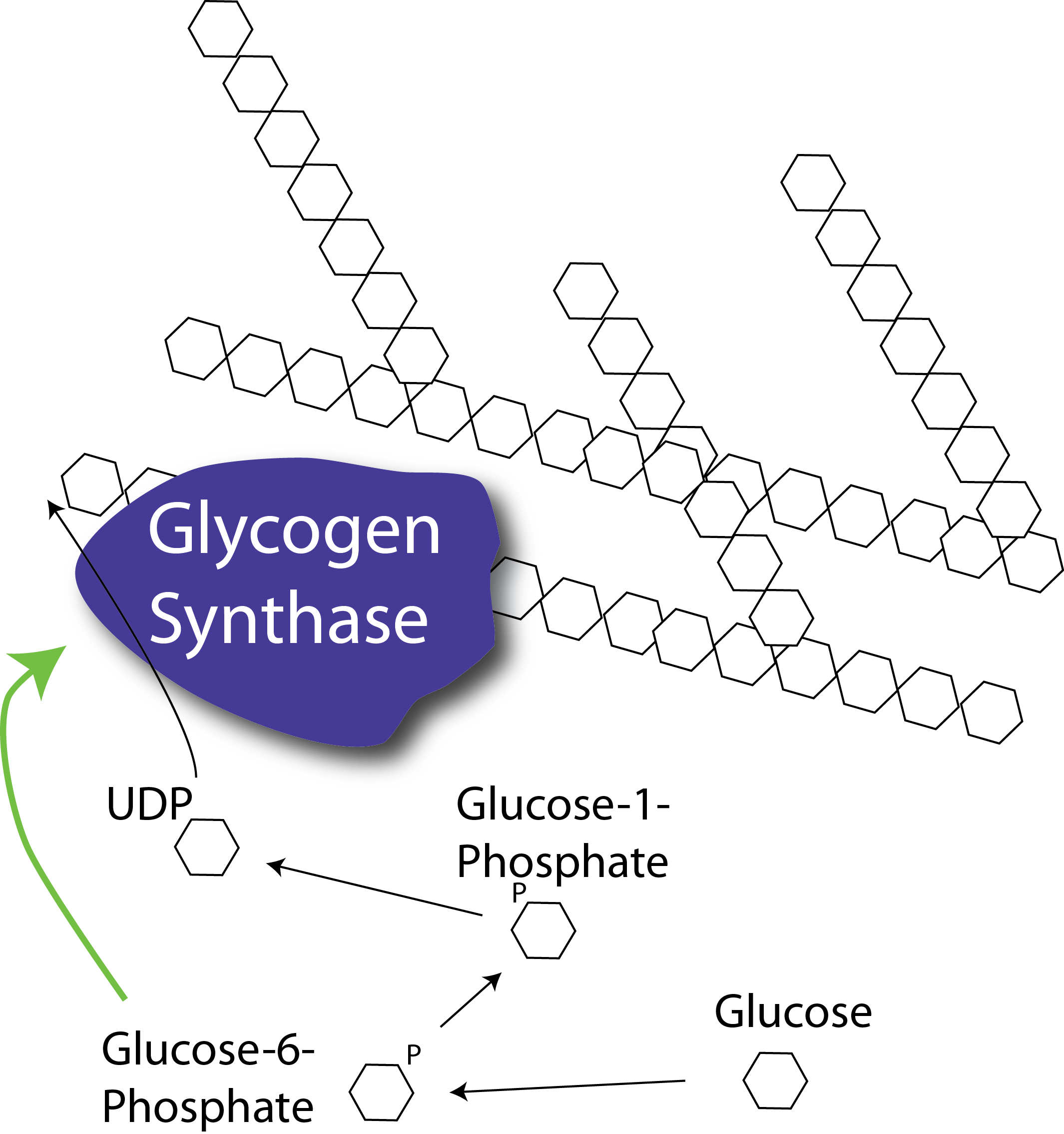
Glycogenesis
Notes:
Rate limiting step is the regulation of glycogen synthase activity

Slide 13
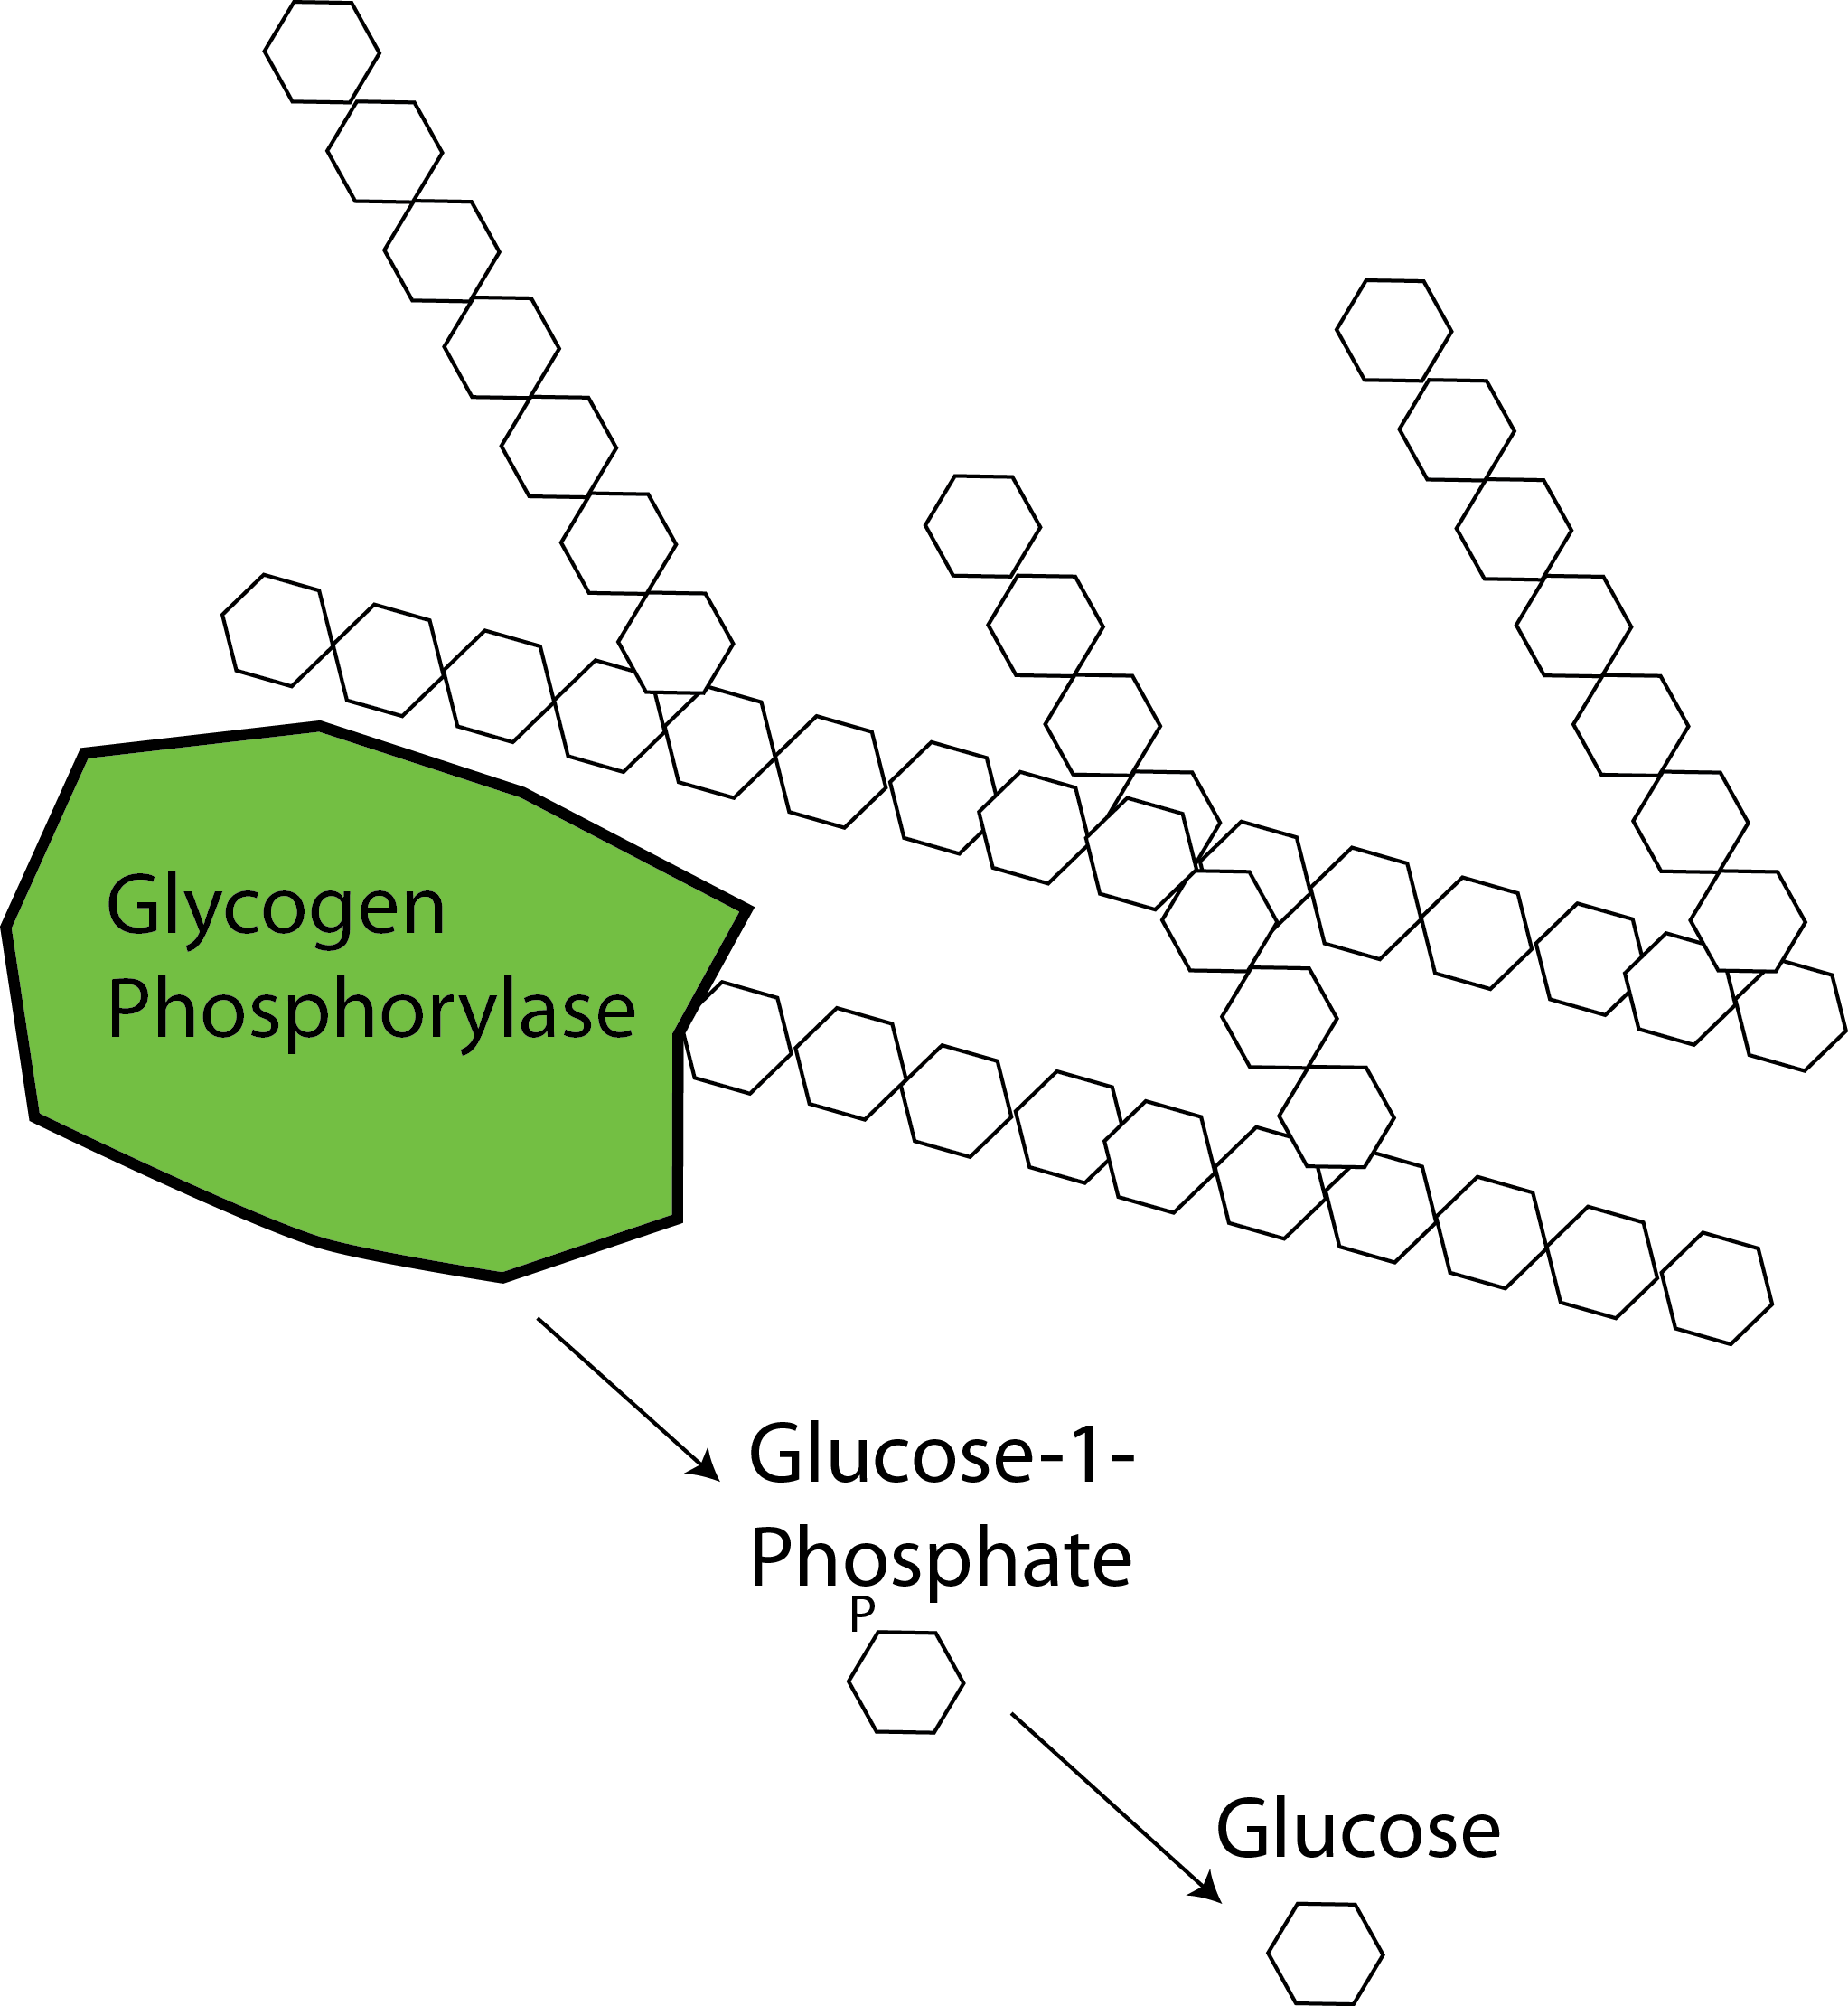
Glycogenolysis

Slide 14
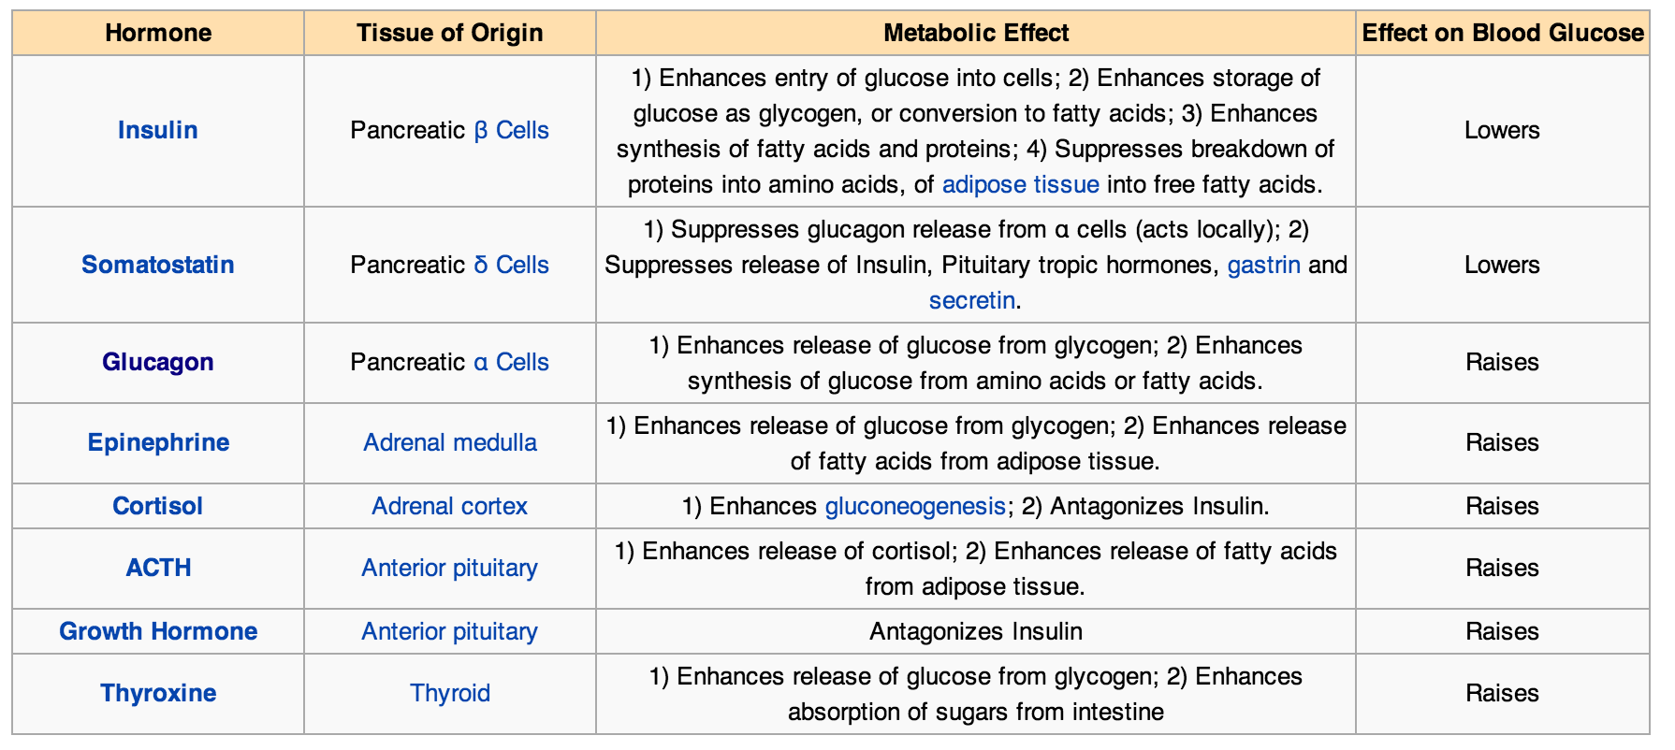
Endocrine Control of Blood Glucose
Blood Glucose in Wikipedia retrieved Oct 30, 2013 from
http://en.wikipedia.org/wiki/Blood_sugar_regulation

Slide 15
Mechanisms to Reduce Blood Glucose

Slide 16

Functions of Insulin
Promotes the uptake of glucose from the blood into muscle and adipose tissue.
Enhances the synthesis of glycogen and triglycerides in liver, adipose and muscle.
Insulin inhibits gluconeogenesis, or the production of glucose from non-glucose precursors such as amino acids and lipids.
Promote glucose breakdown and prevent lipid breakdown
Food
Circulating
Nutrients
(Glucose)
Glucose Production
Glucose Disposal
Insulin
Secretion
Nutrient Storage

Slide 17
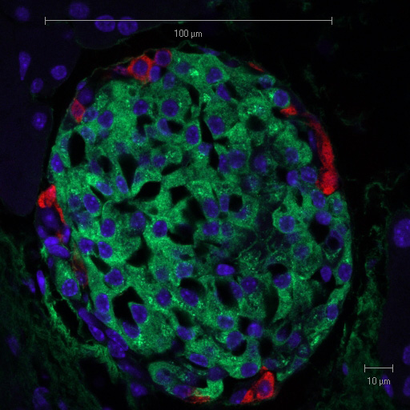
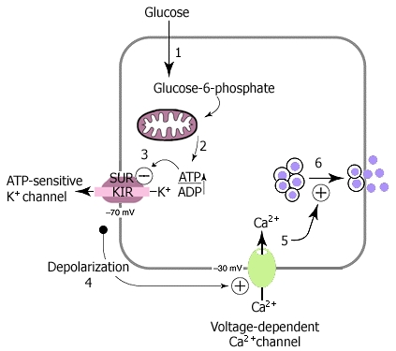
Insulin Secretion
Suckale and Solimena (2008) Frontiers in bioscience 13:7156-71
Pancreatic Islet with Glucagon and Insulin Staining
From Solilema Lab (http://en.wikipedia.org/wiki/Islets_of_Langerhans)
Notes:
Red is glucagon, green is insulin

Slide 18
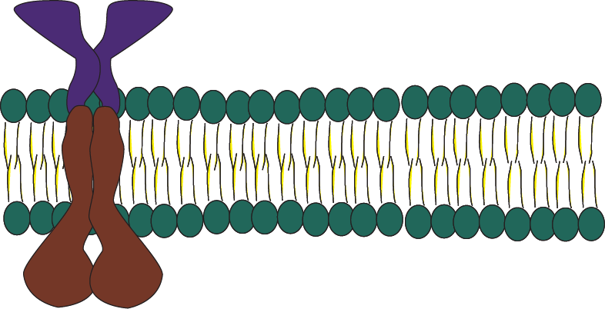
Insulin Signaling – PI3K Signaling
Insulin
P
P
IRS
PI(4,5)P₂
PI(3,4,5)P₃
p85
P
P
P
p110
P
P
P
Class I PI3K

Slide 19
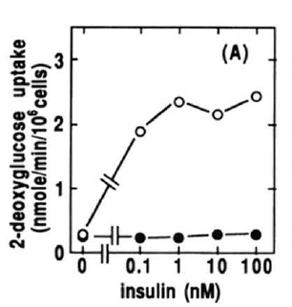
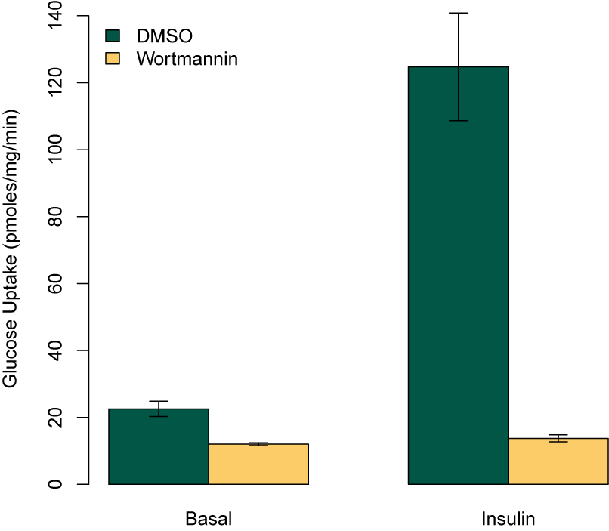
Key Role of PI3K in Insulin Signaling
Kanai et al (1993) Biochem Biophys. Res. Comm. 195:762:768

Slide 20
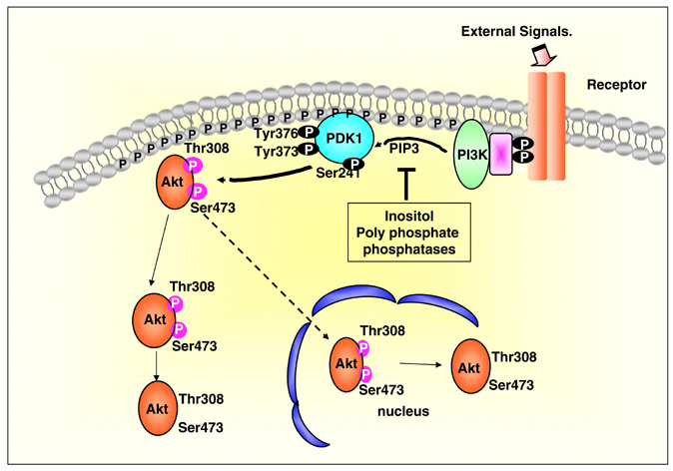
Akt Activation by the PI3K Pathway

Slide 21
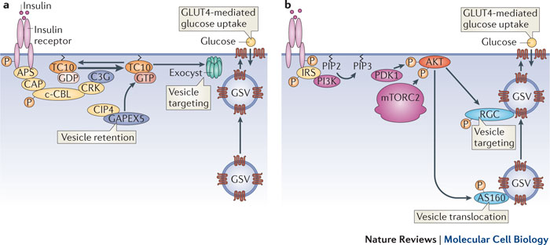
Insulin Stimulated GLUT4 Translocation
Leto and Saltiel Nat. Rev. MCB (2012)

Slide 22
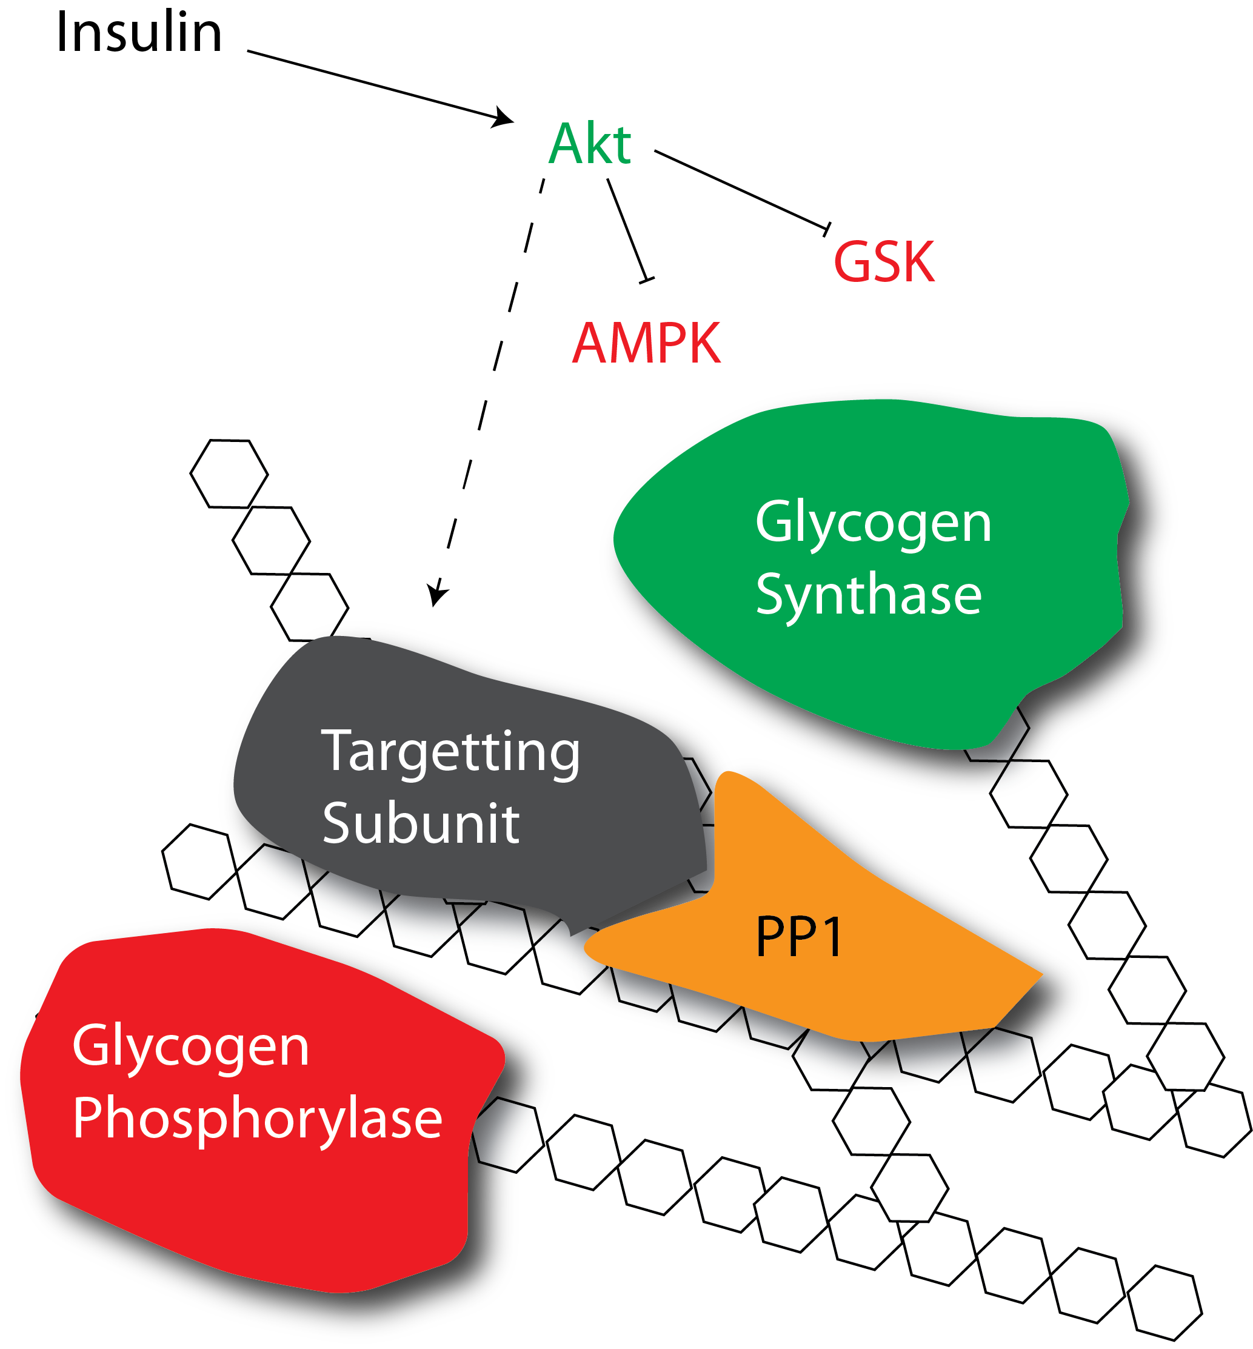
How does insulin promote glycogenesis?
Allosteric activation
Protein phosphorylation
Notes:
First ask about which mediators are increased with insulin, or see what the allosteric activation of GS looks like

Slide 23
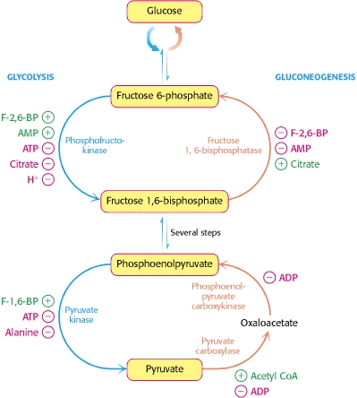
How does insulin reduce gluconeogenesis
FBPase is negatively regulated by F-2,6-BP
PEPCK and G6Pase are inhibited by insulin
Allosterically
Protein phosphorylation
Transcriptionally repressed

Slide 24
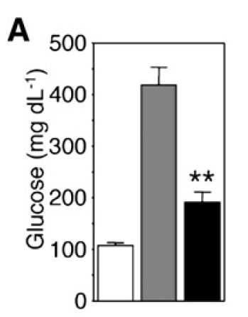
Transcriptional Regulation of Gluconeogenesis
Akt
PEPCK
G6Pase
P
Knockout
IR
IR +
FOXO
FOXO
P
P
Matsumoto et al. (2007) Cell Metab. 6:208-16

Slide 25
Mechanisms to Increase Blood Glucose

Slide 26
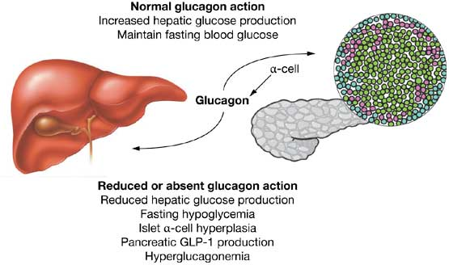
Glucagon Secretion
Secreted from alpha cells of the pancreas
Released by low blood sugar levels
Acts on the liver not the muscle or fat tissues
Drucker (2013): Nat Rev Endo 1:22-31

Slide 27
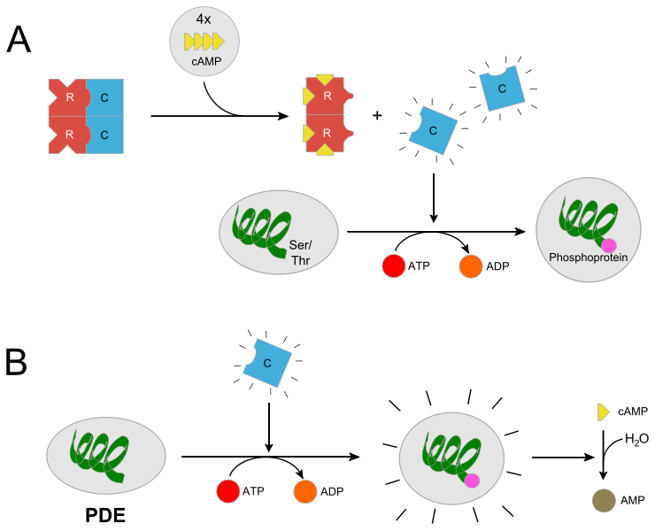
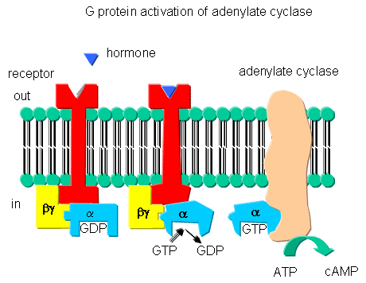
Glucagon Signaling
From http://biowiki.ucdavis.edu/Biochemistry/Signal_Transduction/Signal_Transduction_at_Cell_Membranes%3A_Protein_Kinases_and_Phosphotases
From http://en.wikipedia.org/wiki/Protein_kinase_A

Slide 28
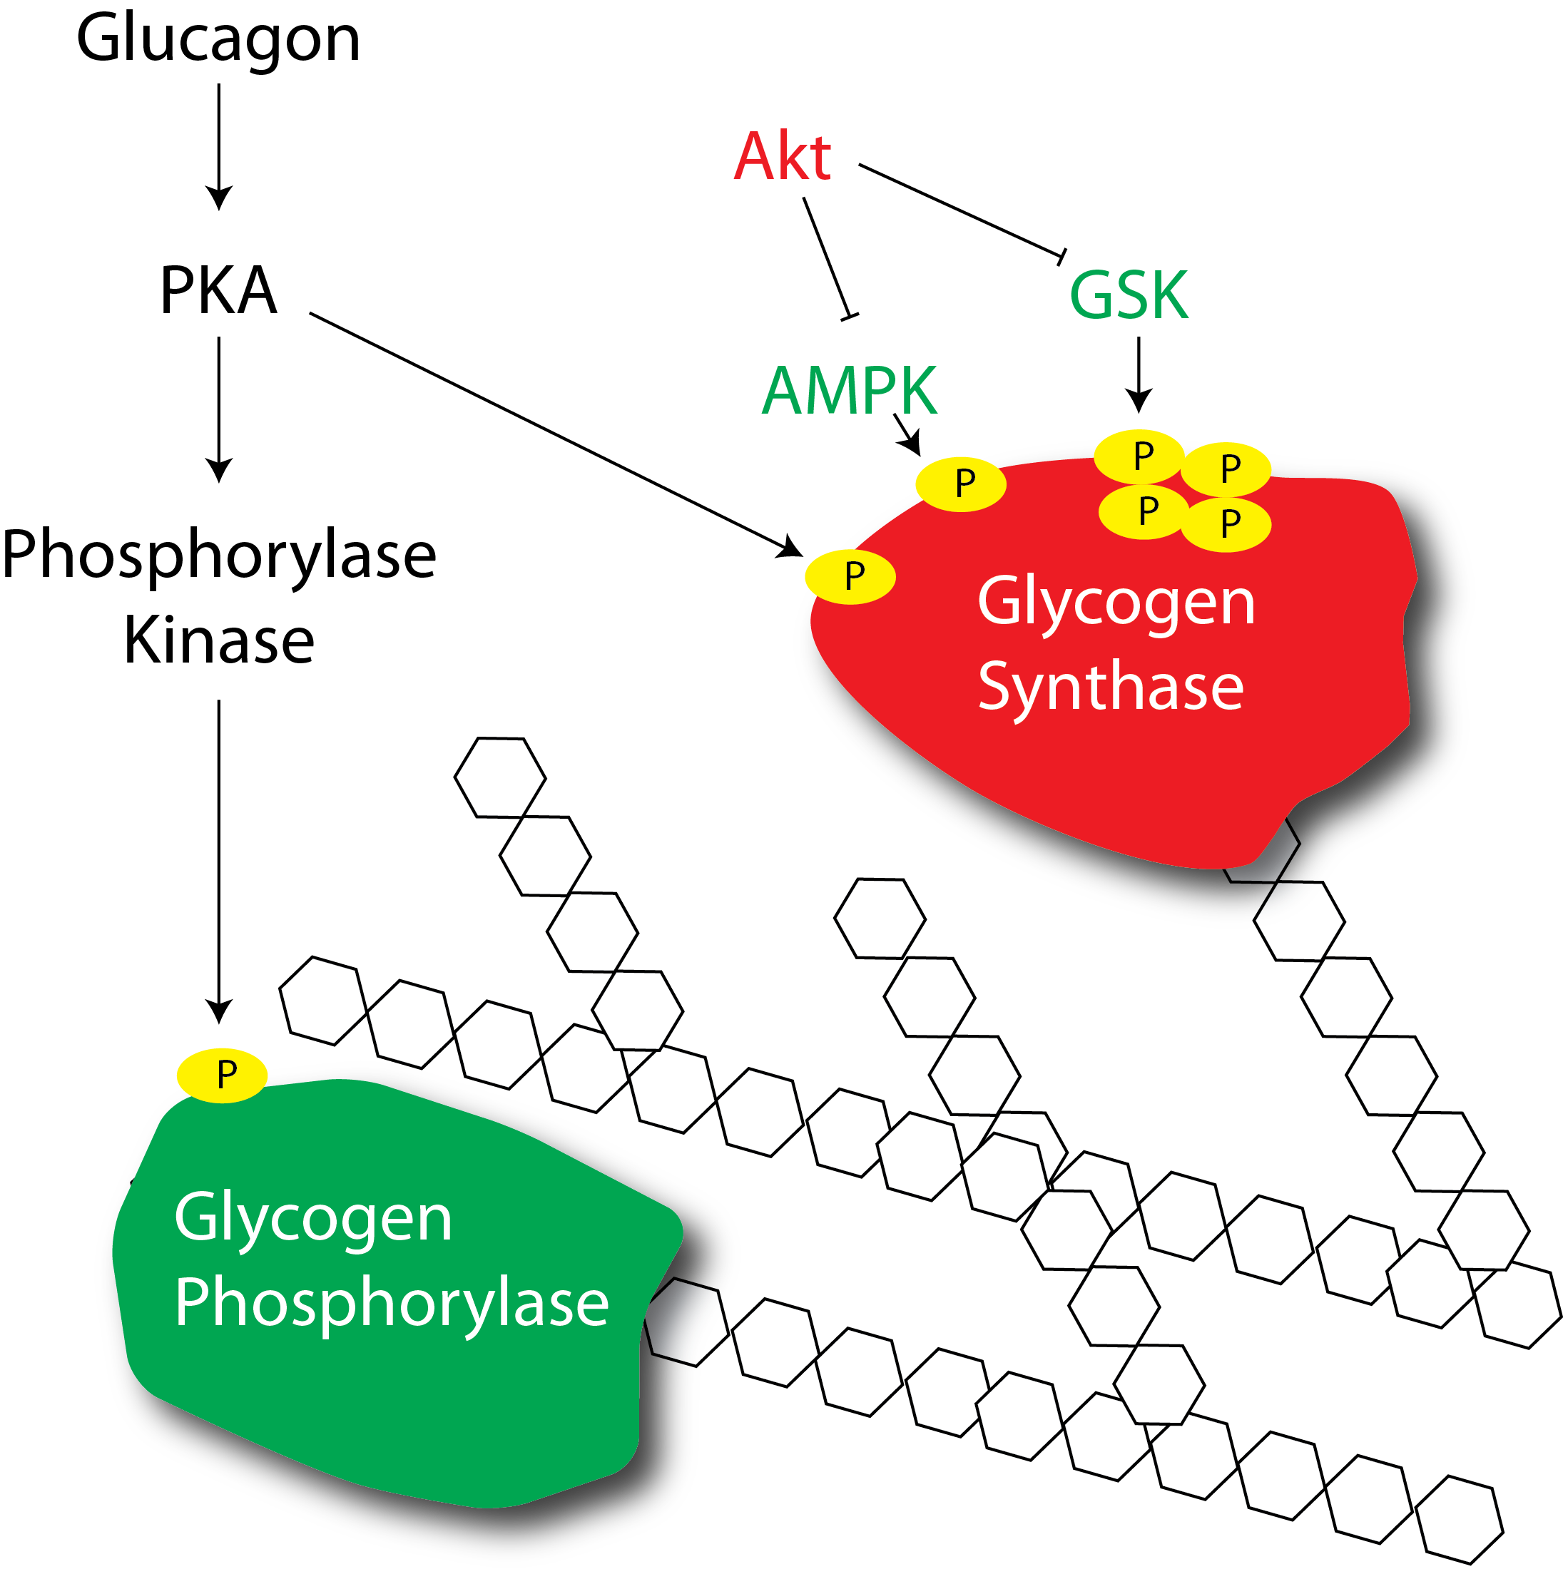
How does glucagon regulate glycogenolysis?

Slide 29
How does glucagon promote gluconeogenesis?
PKA
PFK-2

Slide 30
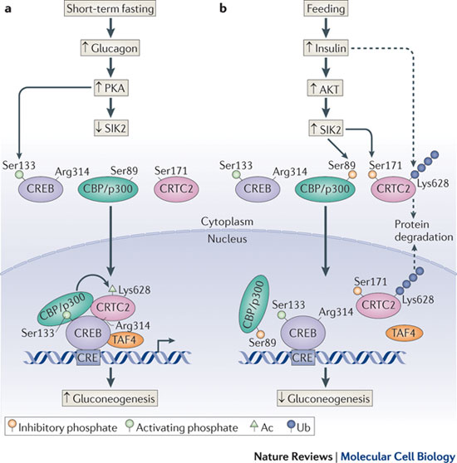
Transcriptional Regulation of Gluconeogenesis
Altajeros and Montminy (2008) Nat. Rev. MCB. 3:141-151

Slide 31
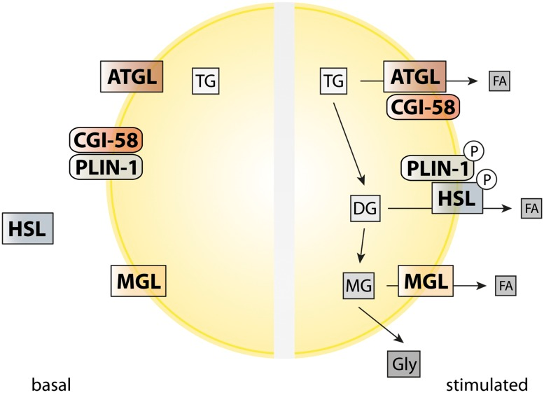
Adrenaline and the Sympathetic Nervous System
Glucagon primarily affects the liver
Adrenaline activates GPCR signaling in fat and muscle tissue
In fat tissue, the primary function is lipolysis
In muscle the primary function is glycolysis and oxidative respiration
These do not dramatically affect acute glucose homeostasis
Young and Zechner (2013) Genes Dev. 27: 459-84

Slide 32
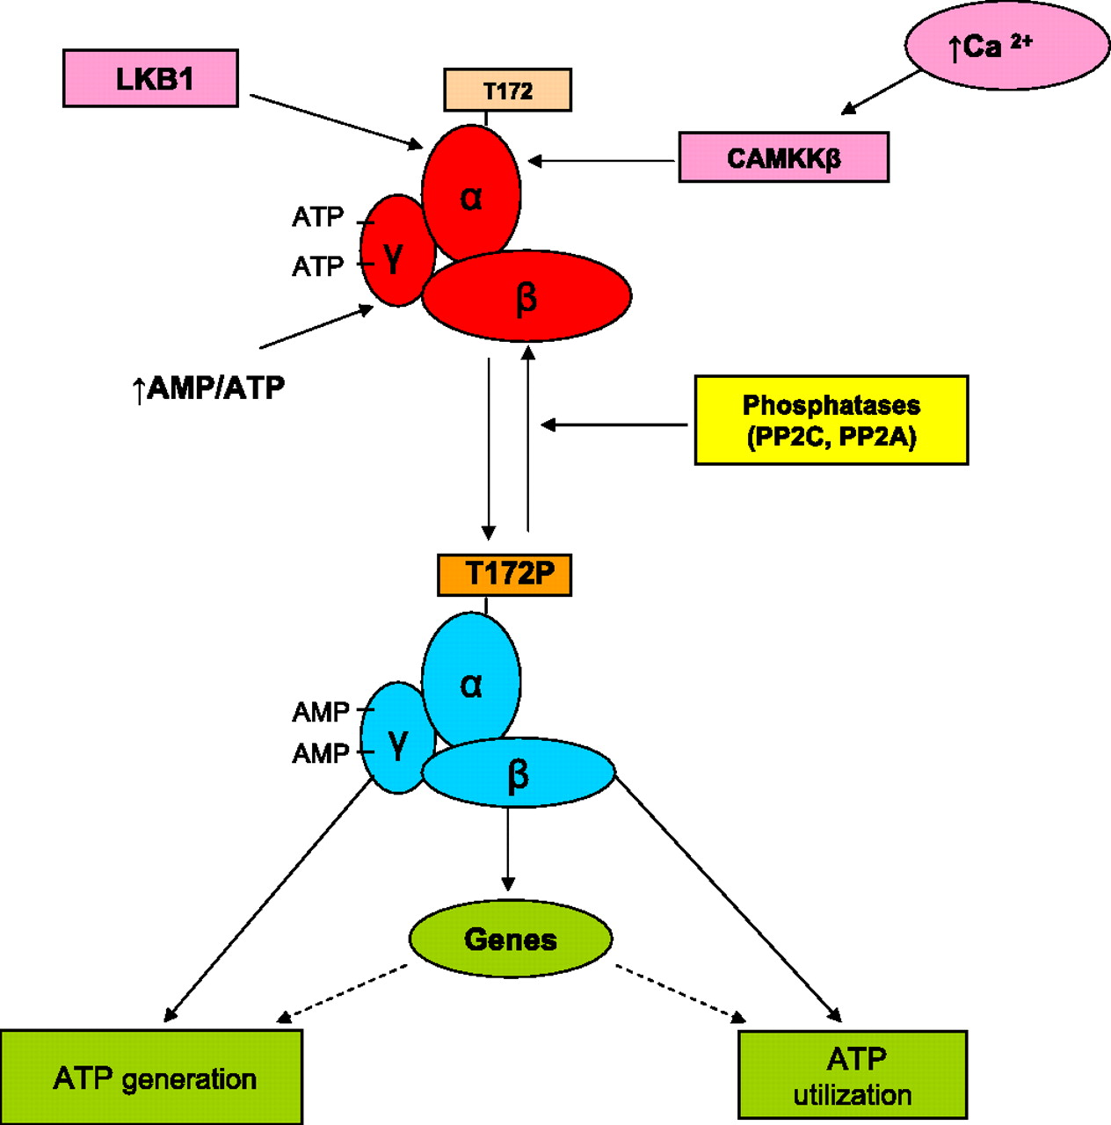
Responses to Energy Stress
Ruderman et al. (2010) Am. J. Physio. 298:E751-760

Slide 33
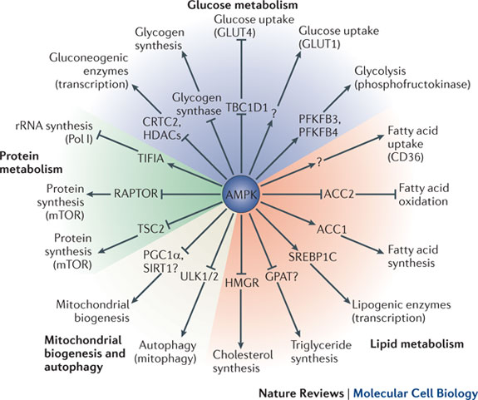
Roles of AMPK
Hardie et al. (2012) Nat. Rev. MCB 13: 251-62

Slide 34
Pathophysiology of Glucose Control

Slide 35
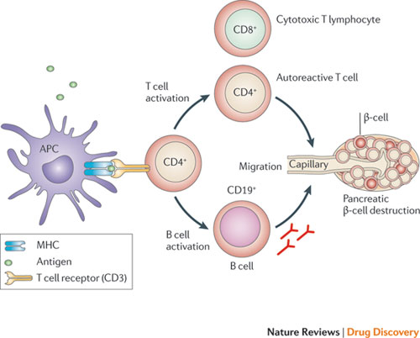
Type I Diabetes Results from a Loss of Beta Cells

Slide 36
Type II Diabetes
Excessive nutrient storage
Tissues Become Insulin Resistant
Pancreas Compensates by Secreting More Insulin to Normalize Glucose
Tissues Become More Insulin Resistant
Eventually Pancreas Fails to Compensate
Hyperglycemia

Slide 37
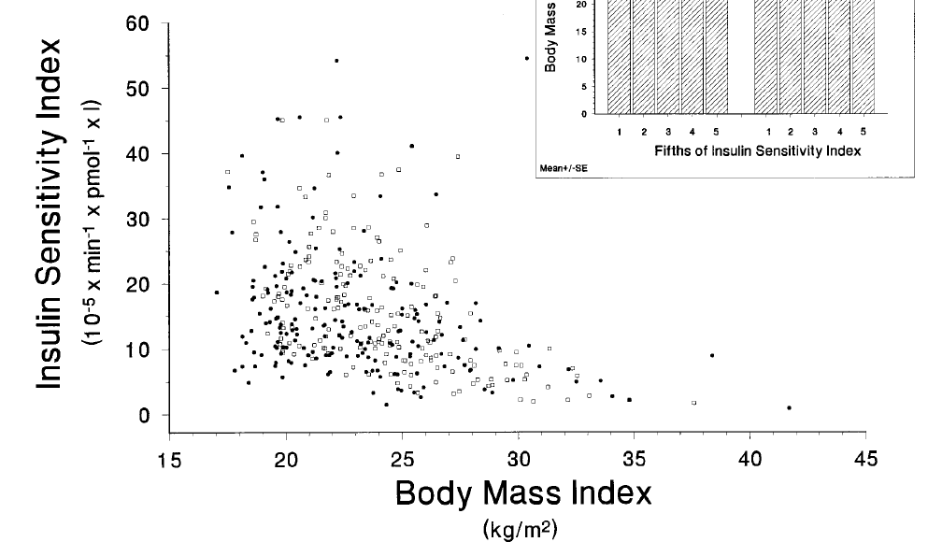
Why Is There Insulin Resistance
Negative feedback loops are common in most endocrine organs
A mechanism to avoid excessive nutrient storage
The “Thrifty Genotype” Hypothesis
Insulin resistance and pancreatic responses underlie progression from weight gain to diabetes
Clausen et al. 1996 J. Clin. Invest. 98:1195–1209
Notes:
Spend some time discussing what would happen if someone is obese but resistant to diabetes

Slide 38
How Does Insulin Resistance Lead to Hyperglycemia/Type II Diabetes?
Reduced disposal of glucose in peripheral tissues (fat and muscle)
Reduced suppression of gluconeogenesis

Slide 39
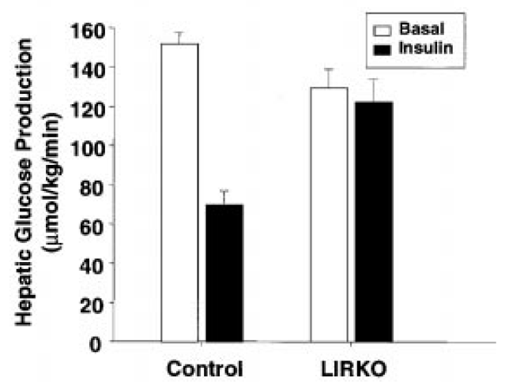
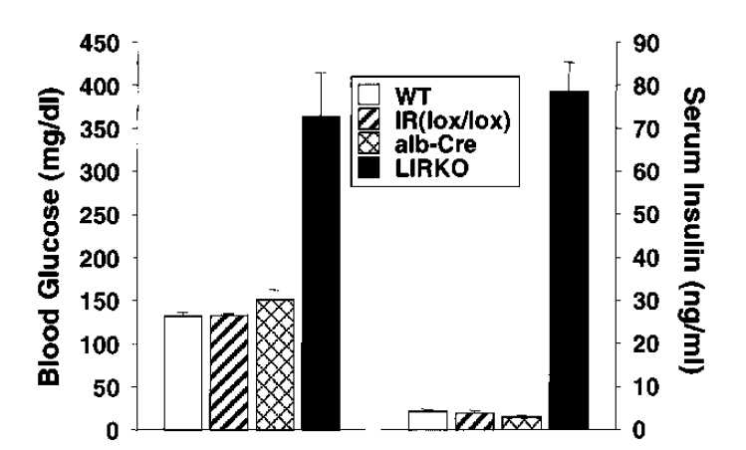
Liver Insulin Receptor Knockout
Michael et al. (2000) Mol Cell 6:87-97

Slide 40
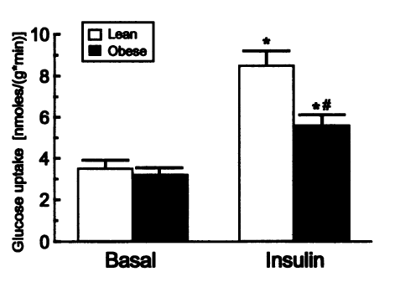
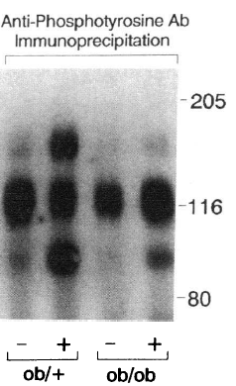
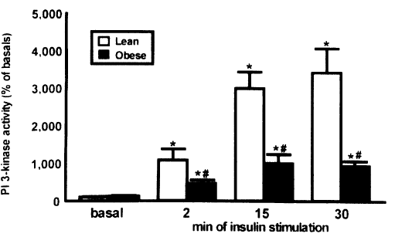
Molecular Mechanisms of Insulin Resistance
Saad et al. (1992)
J. Clin. Invest. 90:1839–1849
Goodyear et al. (1995) J Clin Invest 95: 2195-204

Slide 41
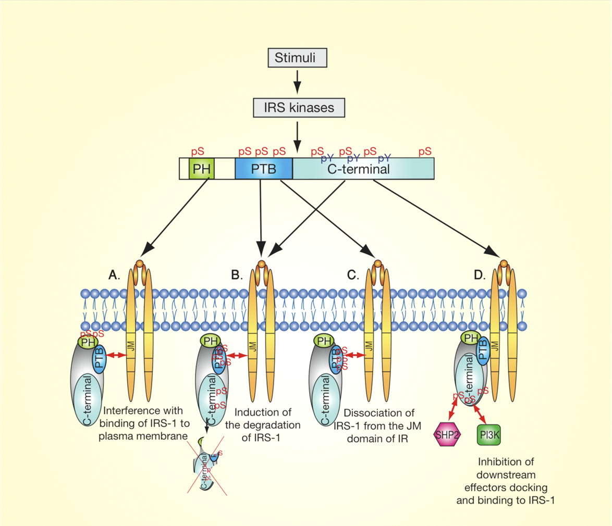
IRS Serine Phosphorylation
Boura-Halfon and Zick (2009) Am. J. Endo. Metab. 296:E581-E591

Slide 42
Mechanisms of Insulin Resistance
Overnutrition induced insulin resistance
Lipid mediated insulin resistance
Inflammation associated insulin resistance

Slide 43
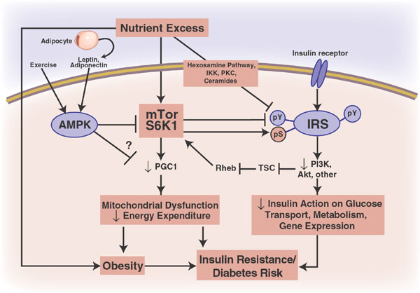
Nutrient Overload -> Insulin Resistance
Patti and Kahn (2009) Nat Med 10:1049-50

Slide 44
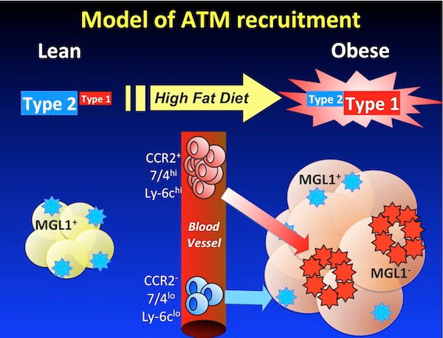
Obesity is an Inflammatory State
Image from http://sitemaker.umich.edu/lumeng.lab/research

Slide 45
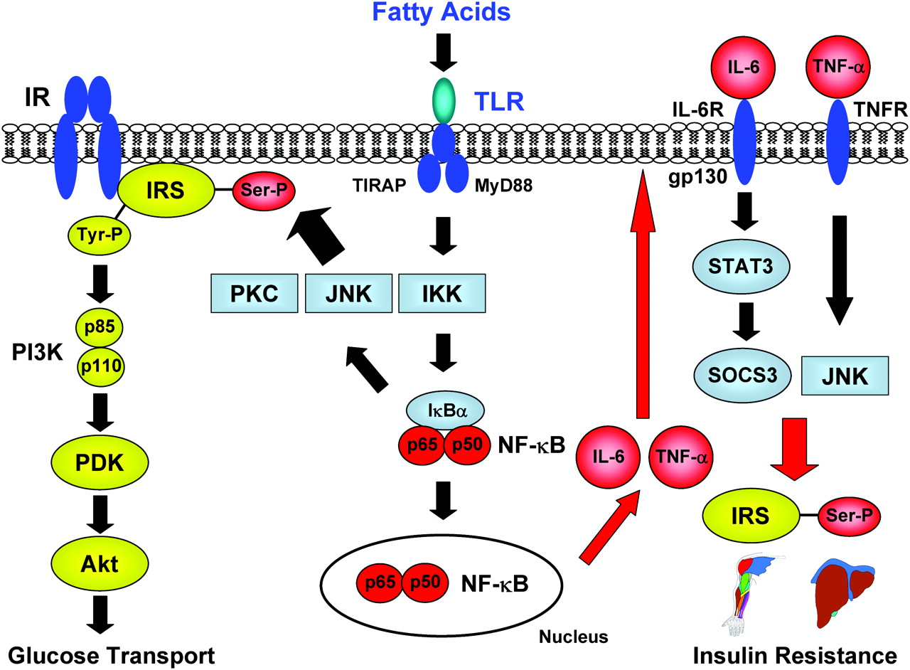
Inflammation -> Insulin Resistance
Kim (2012) Circulation 125: 1081-83

Slide 46
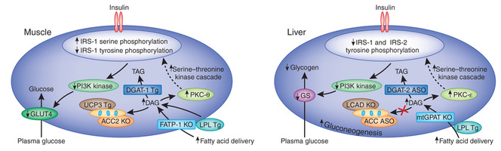
Lipid Accumulation -> Insulin Resistance
Erion and Shulman (2010) Nature Medicine 16:400-402

Slide 47
Several Potential Novel Drug Targets
New drug targets
mTORC1
JNK
Protein Kinase C
What would be the downside of increasing insulin sensitivity in an obese patient?

Slide 48
Treatments for Diabetes

Slide 49
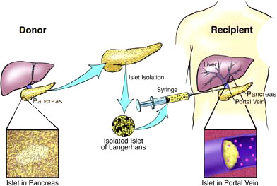
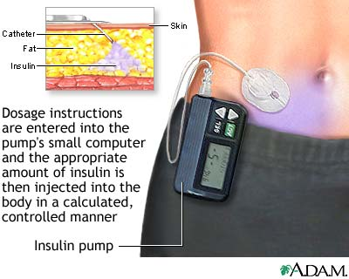
Treatments for Type I Diabetes
Insulin Injections
Islet Transplantations
Long vs Short Acting Insulin
Insulin Pumps

Slide 50
Treatments for Type II Diabetes
Normalize blood glucose levels
Store it in body tissues
Excrete it in the urine
Burn the excess glucose

Slide 51
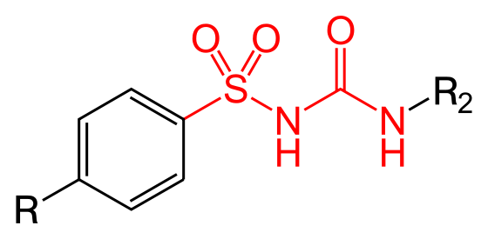
Store Excess Glucose I – Provide or Secrete More Insulin
Sulfonylureas
Tolbutamide
Glyburide
Another class that improves insulin secretion is GLP1 agonists or DPP inhibitors (lecture in 2 weeks by Dr. Cook)
Suckale and Solimena (2008) Frontiers in bioscience 13:7156-71
Notes:
First talk about providing more insulin. What would be the downside of providing more insulin?

Slide 52
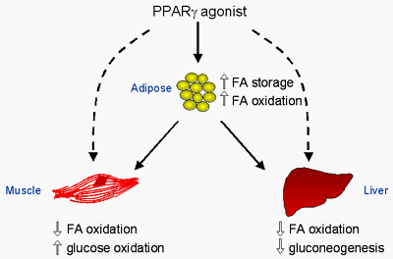
Store Excess Glucose II – Insulin Sensitizers
Thiazolidinediones
Agonists of PPARy transcription factor
Promotes lipid storage and oxidation as well as new fat cells
Rosiglitazone (Avandia) and Pioglitazone (Actos)
Cardiovascular events

Slide 53
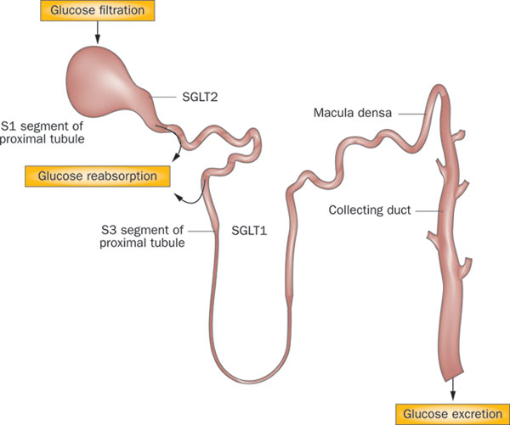
Glucose Secretion
Ferrannini and Solini (2012) Nat Rev Endo 8:495-502

Slide 54
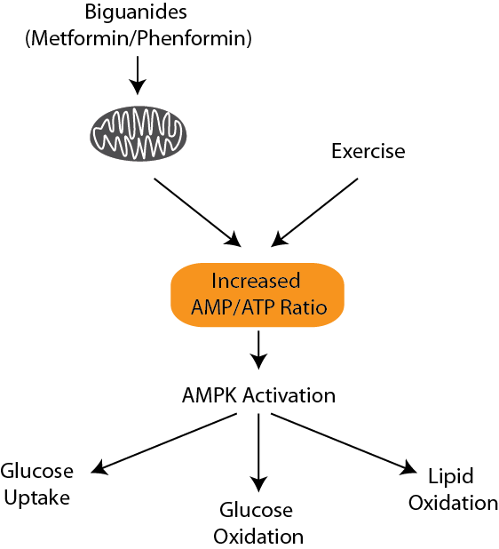
Glucose Utilization
Biguanides Metformin and Phenformin
They cause increases in AMP levels and activation of AMPK signaling
Mimics the effects of exercise

